Slide 1

IPL Analytics
Sahur Maharaj

Slide 2
Objectives
Find cap winners.
Find and compare match statistics.
Compare team statistics.
Find toss winning percentage.
Find total matches won by venue.
Create a Business Requirement Document.
Create a Power BI Report.

Slide 3
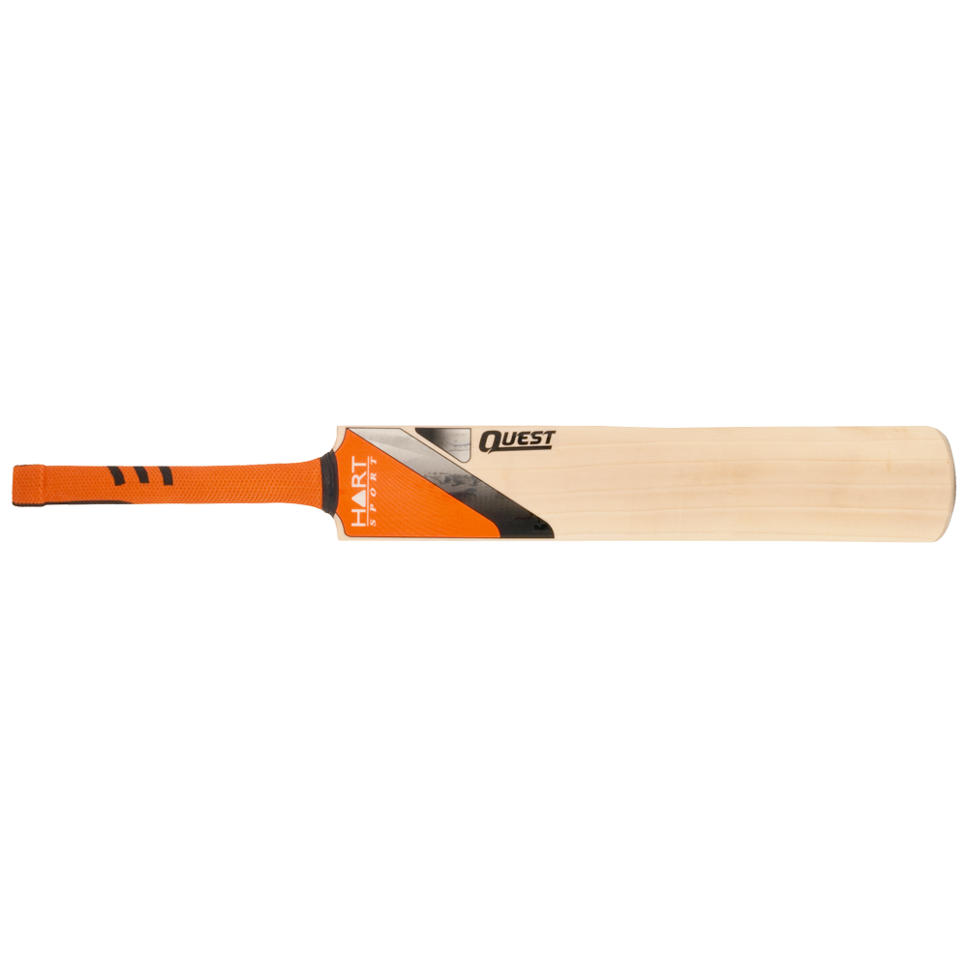
Business Requirement Document
IPL BRS Document.

Slide 4
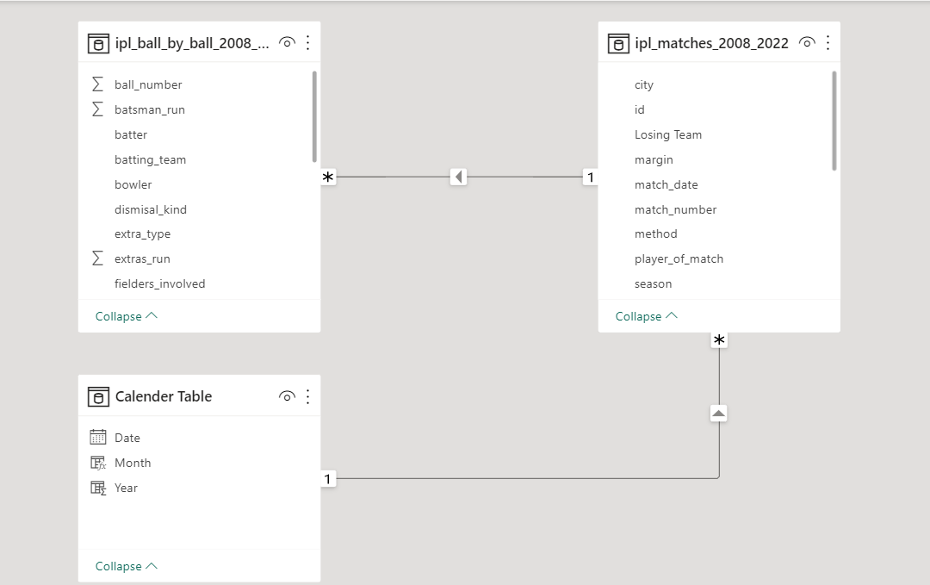
Data Model

Slide 5
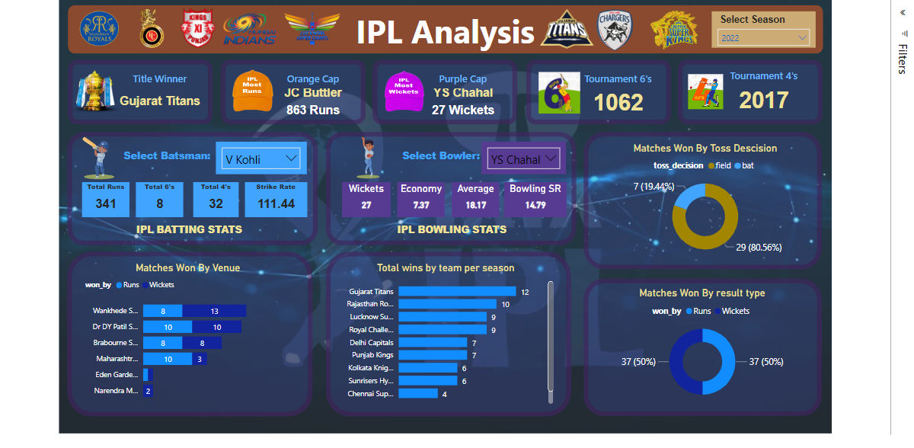

Slide 6

Thank You

